Slide 1

Extending the MOC-UI
Thomas Hsu, Bill Vangos, Alex Wong, Hang Xu
Project Mentor: Jon Bell

Slide 2
MOC-UI Recap
A user interface for the Massachusetts Open Cloud, a collaboration between universities in the Boston area.
We seek to develop a dynamic marketplace and provide a friendlier user experience than the Horizon UI

Slide 3
Where We Left Off
Created and initialized database to manage projects/services.
Modified ‘views’ code to query the new database for services
Implemented filter into marketplace sidebar

Slide 4
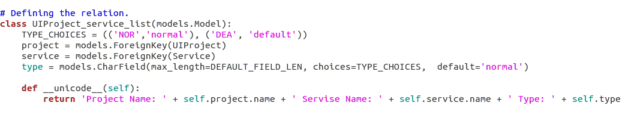
This Sprint: Associating Services
models.py
Added projects to database
Created UIProject_service_list model to store the relationship between a project and service

Slide 5
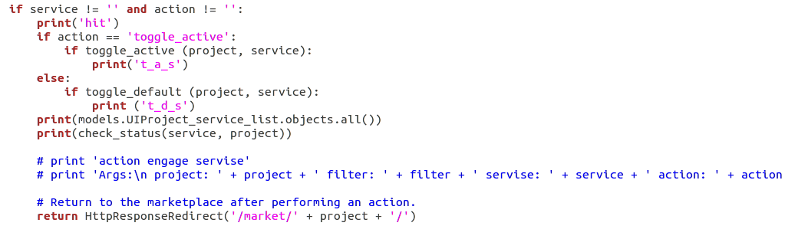
This Sprint: Cont
views.py
Modified ‘views’ to query the database for this association
Implemented button toggle in marketplace to make association

Slide 6
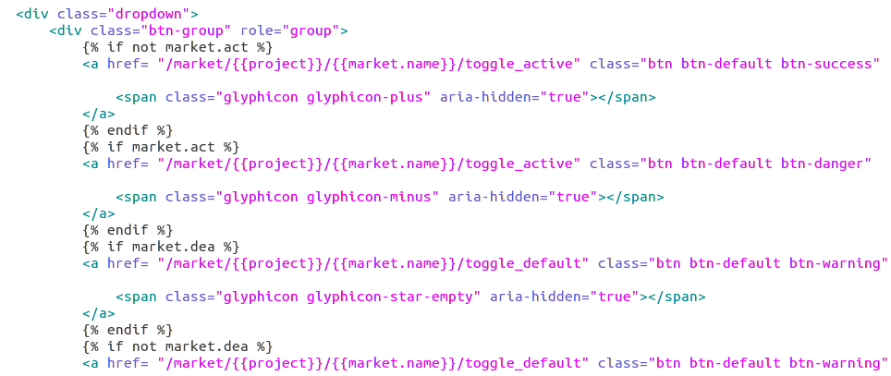
This Sprint (cont)
market.html

Slide 7
Demo

Slide 8
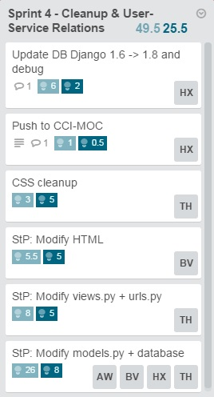
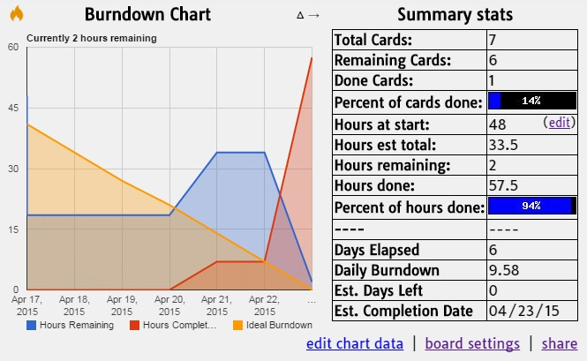
Burn Down

Slide 9
Next Sprint
Increased Marketplace Functionality
  Implement remaining buttons, search function, etc.
  Fix broken urls
  General CSS cleanup
Will be discussed with our mentor this weekend

Slide 10
Thanks

